Slide 1
About Me
Ritesh Singh
Sun Certified java Professional
Oracle Certified Database Administrator
Certified Ethical Hacker
Certified EC-Council Instructor (CEI)

Slide 2
Course Overview
Introduction to SQL DISTINCT operator

Slide 3
Introduction to SQL DISTINCT operator
The primary key ensures that the table has no duplicate rows. However, when you use the SELECT statement to query a portion of the columns in a table, you may get duplicates.
To remove duplicates from a result set, you use the DISTINCT operator in the SELECT clause as follows:
SELECT DISTINCT
column1, column2, ...
FROM
table1;

Slide 4
If you use one column after the DISTINCT operator, the database system uses that column to evaluate duplicate. In case you use two or more columns, the database system will use the combination of value in these columns for the duplication check.
To remove the duplicates, the database system first sorts the result set by every column specified in the SELECT clause. It then scans the table from top to bottom to identify the duplicates that are next to each other. In case the result set is large, the sorting and scanning operations may reduce the performance of the query.

Slide 5
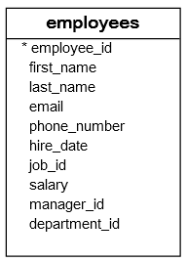
SQL DISTINCT examples
We will use the employees table in the sample database to demonstrate how the DISTINCT operator works.

Slide 6

1) Using SQL DISTINCT on one column example
The following statement retrieves the salary data from the employees table and sorts it in descending order.
SELECT
salary
FROM
employees
ORDER BY salary DESC

Slide 7

As you see we have duplicate salary data e.g., 17,000 because two or more employees have the same salary. To remove the duplicate, you add the DISTINCT operator to the SELECT clause as follows:
SELECT
DISTINCT salary
FROM
employees
ORDER BY salary DESC;
Now all duplicates are removed from the result set.

Slide 8
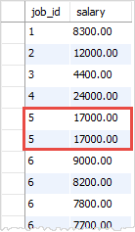
2) Using SQL DISTINCT on multiple columns example The following statement retrieves the job id and salary from the employees table.
SELECT
job_id,
salary
FROM
employees
ORDER BY
job_id,
salary DESC;

Slide 9
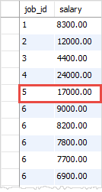
Now if you add the DISTINCT operator to the SELECT clause, the database system uses values in both job_id and salary columns to evaluate duplicates. It keeps only one of the highlight rows as shown in the screenshot above.
SELECT DISTINCT job_id, salary FROM employees ORDER BY job_id, salary DESC;

Slide 10
SQL DISTINCT and NULL values
In the database world, NULL is special. NULL values are used as markers to indicate that the information is missing or not applicable.
For this reason, NULL cannot be compared to any value. Even NULL is not equal to itself. If you have two or more NULL values in a column, does the database system consider them as the same or distinct values?
Typically, the DISTINCT operator treats all NULL values the same. As a result, the DISTINCT operator keeps only one NULL value and removes the other from the result set.

Slide 11
For example, the following statement returns the distinct phone numbers of employees.
SELECT DISTINCT
phone_number
FROM
employees;
Notice that it returned only one NULL value.

Slide 12
Summary
In this tutorial, you have learned how to use the SQL DISTINCT operator to remove duplicate rows from a result set.

Slide 13
Thank You
Please Subscribe My Channel
https://www.youtube.com/channel/UCYW3PWPOPn3qgxxjhUbXXXg?view_as=subscriber

